Slide 1
IOT BASED FALL DETECTION SYSTEM USING NODEMCU AND MPU6050 SENSOR TEAM MEMBERS: MENTOR DETAILS : E.G.PRADEEP SAYED Founder of S.ZAMEER BASHA P.SURRYA DURAI
Aruvi old age home

Slide 2
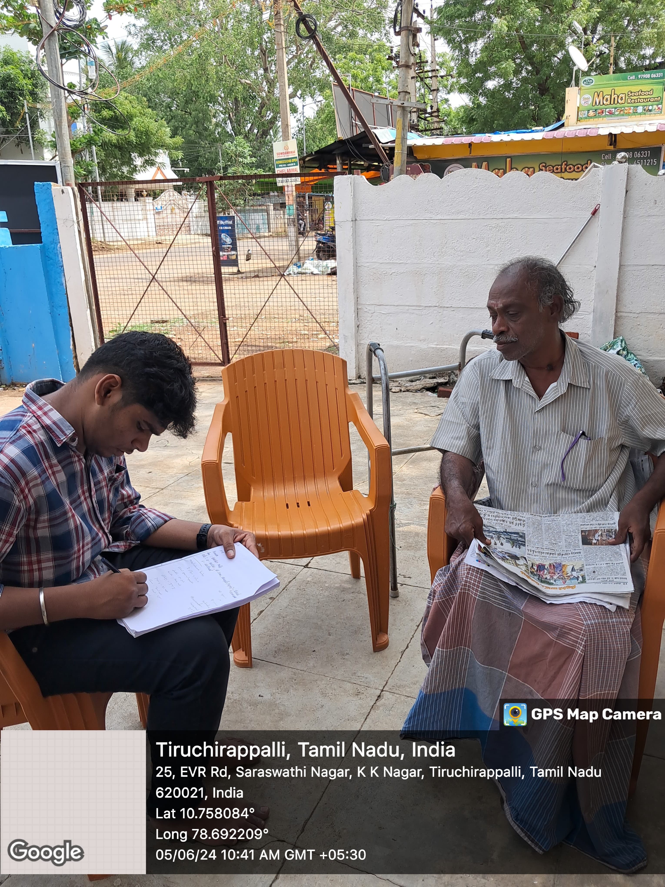
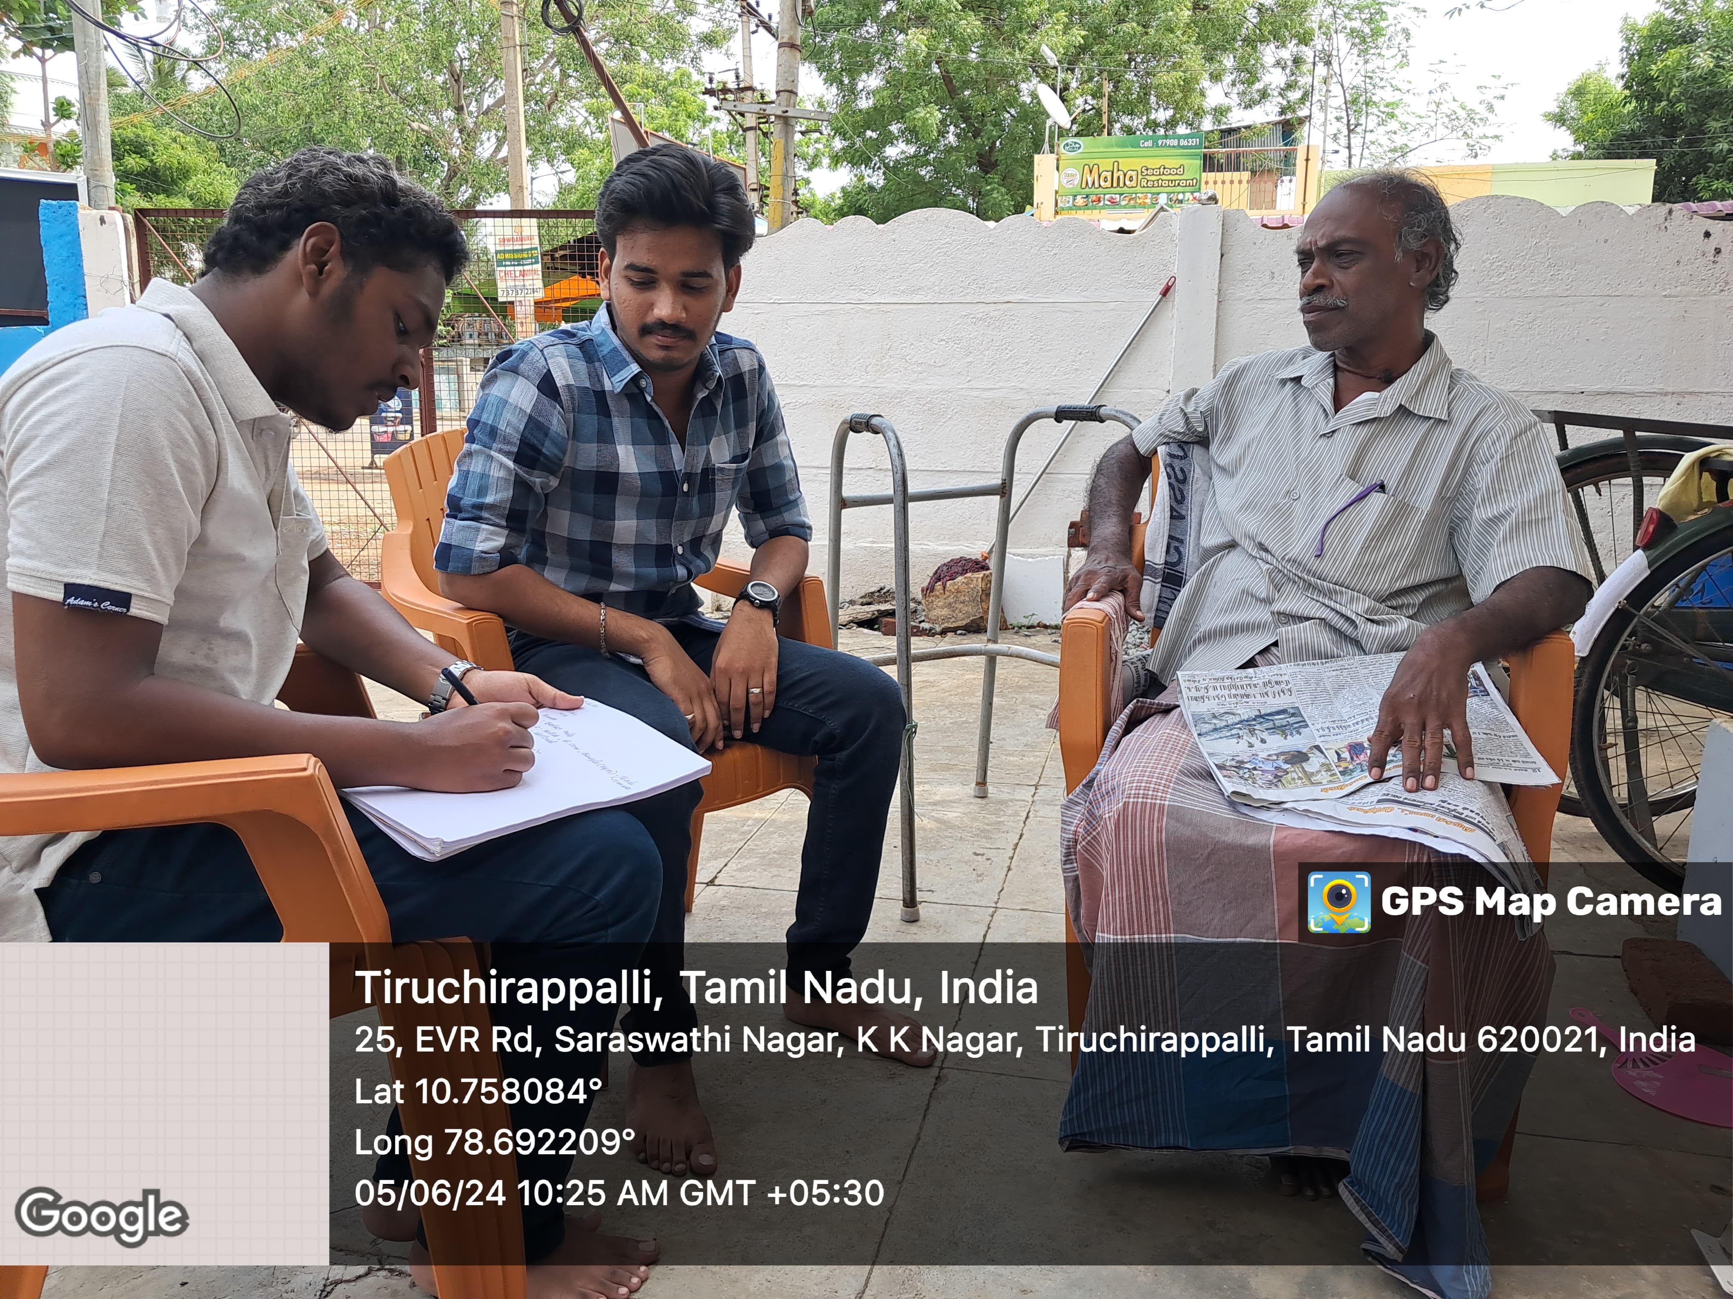
PROBLEM STATEMENT :
Enhancing Safety and Independence for Disabled Persons through Fall Detection Technologies. In our visited NGO, An old person named Venkateshwaraa babu have lost his leg and have faced many mobility issues. We have observed that he can’t do his daily routines properly. We also examined that the use and limitations of wheelchairs, walking sticks etc.. He can’t do proper walking without a wheelchair. He said that he fell away, when he was sleeping.

Slide 3
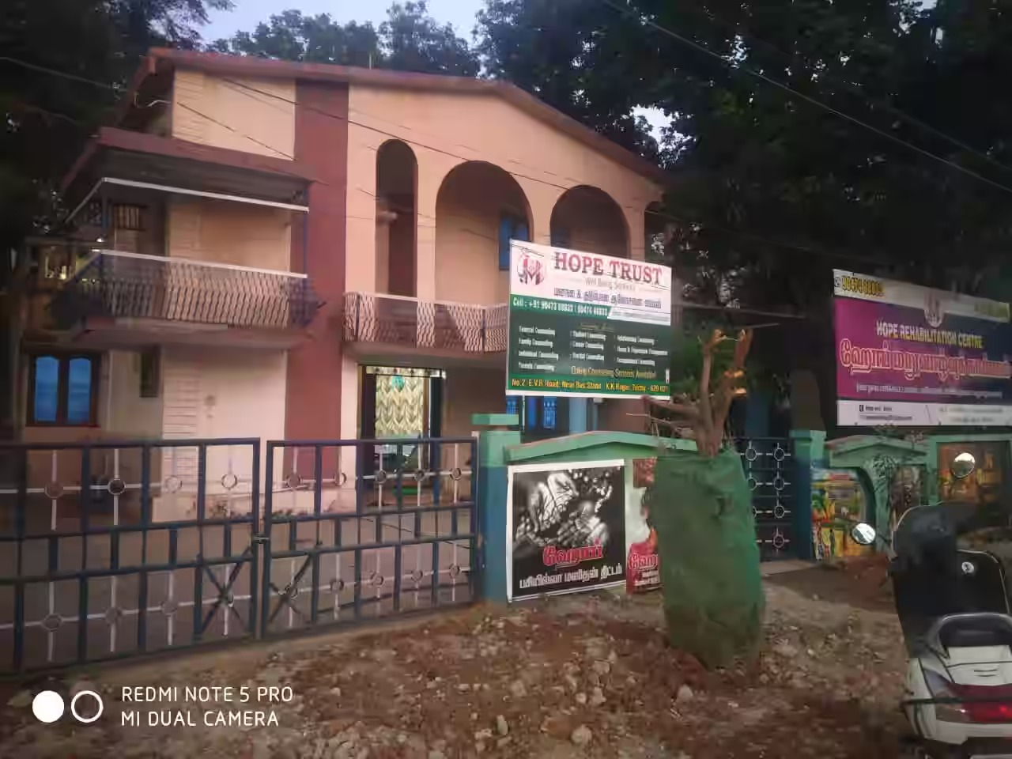
ABOUT OUR VISITED NGO:
NGO : Aruvi old age Home Location : No.2, EVR Rd, near Bus Stand, Saraswathi Nagar, K K Nagar, Tiruchirappalli, Tamil Nadu 620021 Website :aruvifoundation.org E-Mail Id: aruvioldagehome@gmail.com
Visited Duration in our NGO : 4 WEEKS
Key contact person : Geeva Contact no:8940319119 Designation : Resepnalist at Aruvi Old age Home,Trichy-21

Slide 4
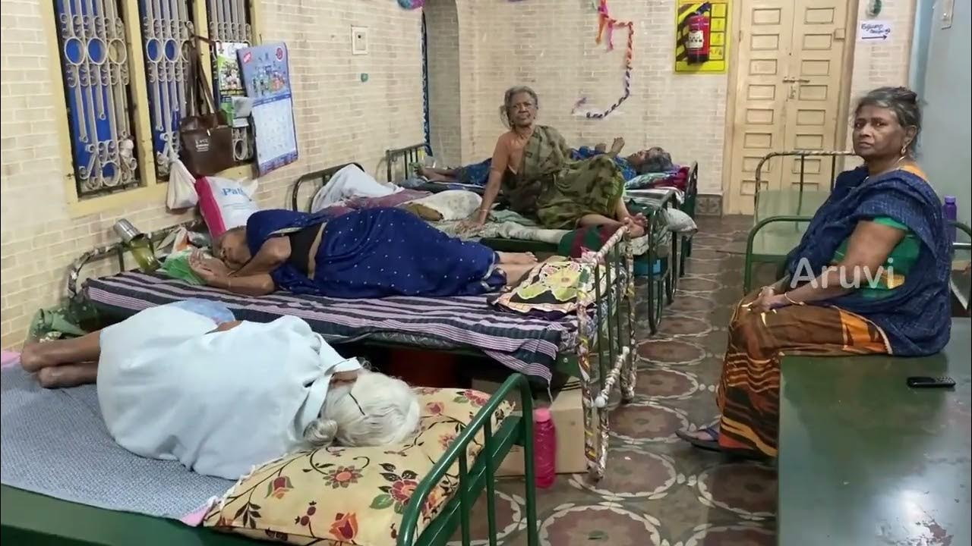
THEMATIC AREA AND ITS MAPPING TO SDG : The NGO we visited provides unique rooms tailored to meet the needs of the elderly. They create an environment that enhances the well-being and quality of life for their residents by offering comprehensive care, including medical services, personal assistance, social activities, and a safe living space. Their focus is on addressing physical, emotional, and social needs, reducing feelings of loneliness and isolation, and managing chronic conditions like diabetes and heart diseases with specialized care plans.

Slide 5
PROPOSED ENGINEERING SOLUTION: Working principle: The fall detection system using the MPU6050 sensor and NodeMCU operates by continuously monitoring the accelerometer and gyroscope data from the MPU6050. The sensor measures the acceleration along the X, Y, and Z axes and detects rotational motion. The NodeMCU processes this data to identify sudden changes in acceleration and specific angular movements indicative of a fall. When such patterns are detected, the NodeMCU triggers an alert, which is sent via Wi-Fi to a pre-configured server or mobile application, ensuring timely assistance for the user. Components Used : NodeMCU (ESP8266) MPU6050 Sensor Power Supply Connecting Wires Breadboard

Slide 6
NON – PROFIT ALIGNMENT : Non-profit organizations serving disabled people have specific needs to effectively support their beneficiaries. Our observations show they help many disabled individuals live independently, fulfilling their needs within the community. Certified Nursing Assistants (CNAs) are always available to assist and interact with the disabled. Fundraising among NGOs boosts support for disabled persons in society. The collaboration between community work and NGOs is essential in helping disabled individuals, creating a support network that addresses their diverse needs, raises awareness, and fosters a more inclusive and supportive environment.

Slide 7
PROPOSED MILESTONES AND TIMELINES : WEEK 1 : GOT INTRODUCED WITH THE DISABLED PEOPLES WEEK 2 : INDENTIFIED THE NEEDS OF THE DISABLED PERSONS WEEK 3 : INITIATED A GROUP TO SOLVE THEIR PROBLEMS WEEK 4 : DEVELOPED A PROTOTYPE TO FULLFILL THEIR NEEDS

Slide 8
Proposed budget
SI.NO. | EQUIPMENT/FACULTIES | QTY. | TOTAL(in.Rs) | Specifications
1 | NodeMCU | 1 | 150 | (ESP8266)
2 | MPU6050 Sensor | 1 | 250
3 | Power Supply | 1 | 100 | HW Battery
4 | Connecting Wires | Few | 100 | Any Colour
5 | Bread board | 1 | 90
 |  | Grand total | 690

Slide 9
CONCLUTION : During Over four weeks, we engaged with the community to understand their needs, collaborated with local organizations, and developed practical solutions to enhance accessibility. By implementing feedback and making necessary adjustments, we were able to create an inclusive environment that addresses the mobility challenges faced by disabled individuals. The project's success highlights the importance of community involvement and collective effort in improving quality of life. The prototype not only provided immediate benefits but also laid the groundwork for sustainable, long-term solutions.

